Slide 1
Predicting Parents Phone Preferences
A look at the factors that contribute to letting <12 year old children own phones.

Slide 2
Background Material
Pew Research conducted a survey of Parents perceptions and practices around Phone ownership and Social Media practices.
https://www.pewresearch.org/internet/2020/07/28/parenting-children-in-the-age-of-screens/

Slide 3
Data : Features Considered
TIMESPEND_a_W63 : How much time do you spend on your phone?
SNSUSE_W63 : Do you use social media?
EASYHARD_W63 : For most parents do you think parenting is...
DOV_KIDS0TO11_W63 : How many children aged 0-11 do you have?
KIDSATHOME_W63 : How many children aged 0-11 live at your home?
PARENTTIME_W63 : Thinking about the amount of time you spend with your children, in general, do you think you spend?
PARENTJOB_W63 : When thinking about your role as a parent, how would you rate the job you do?
RISKBEN_W63 : Thinking generally about children who are 11 years old or younger, which would you say most accurately describes how you feel, even if neither is exactly right?
F_METRO : Do you live in a Metropolitan area?
F_AGECAT : What age groupe are you in?
F_CREGION : Geographic region
F_SEX : Sex
F_EDUCCAT2 : Degree obtained
F_MARITAL : Marital Status
F_PARTY_FINAL : Political Party
F_INCOME_RECODE : Income
F_ACSWEB : Do you have internet?

Slide 4

Insights: Features of Importance
Number of Kids
Parents perception of their parenting
Parents perception of Smartphone Risk
Region
Education Level
Relationship Status
Political Affiliation
Income (Not used in model)

Slide 5
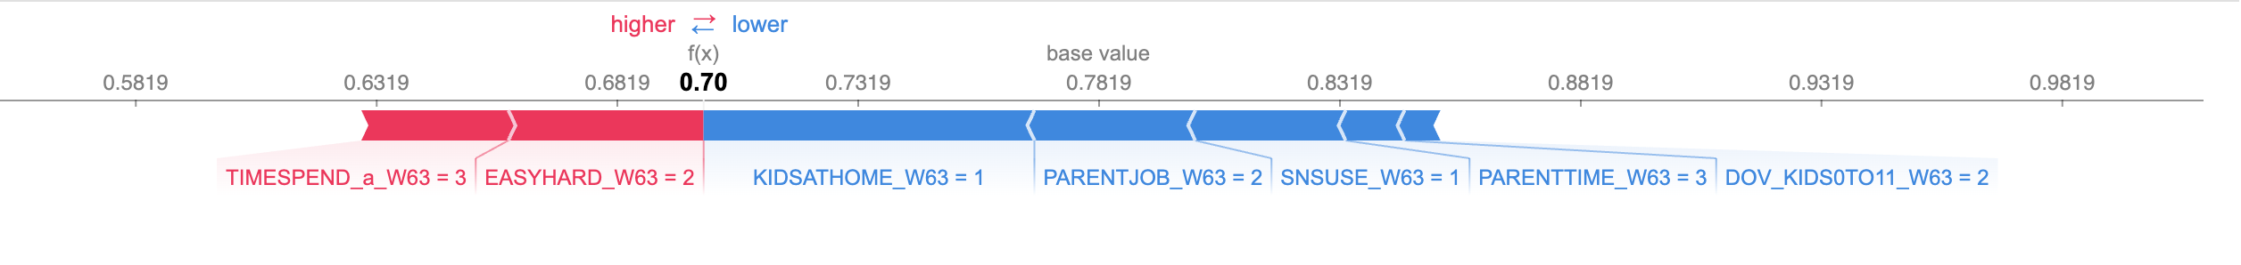
Insights: Base Rates

Slide 6
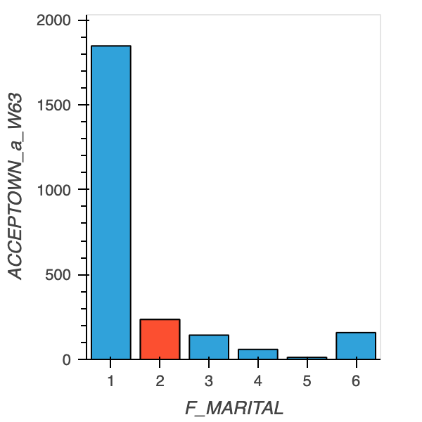
Insights: Base Rates

Slide 7
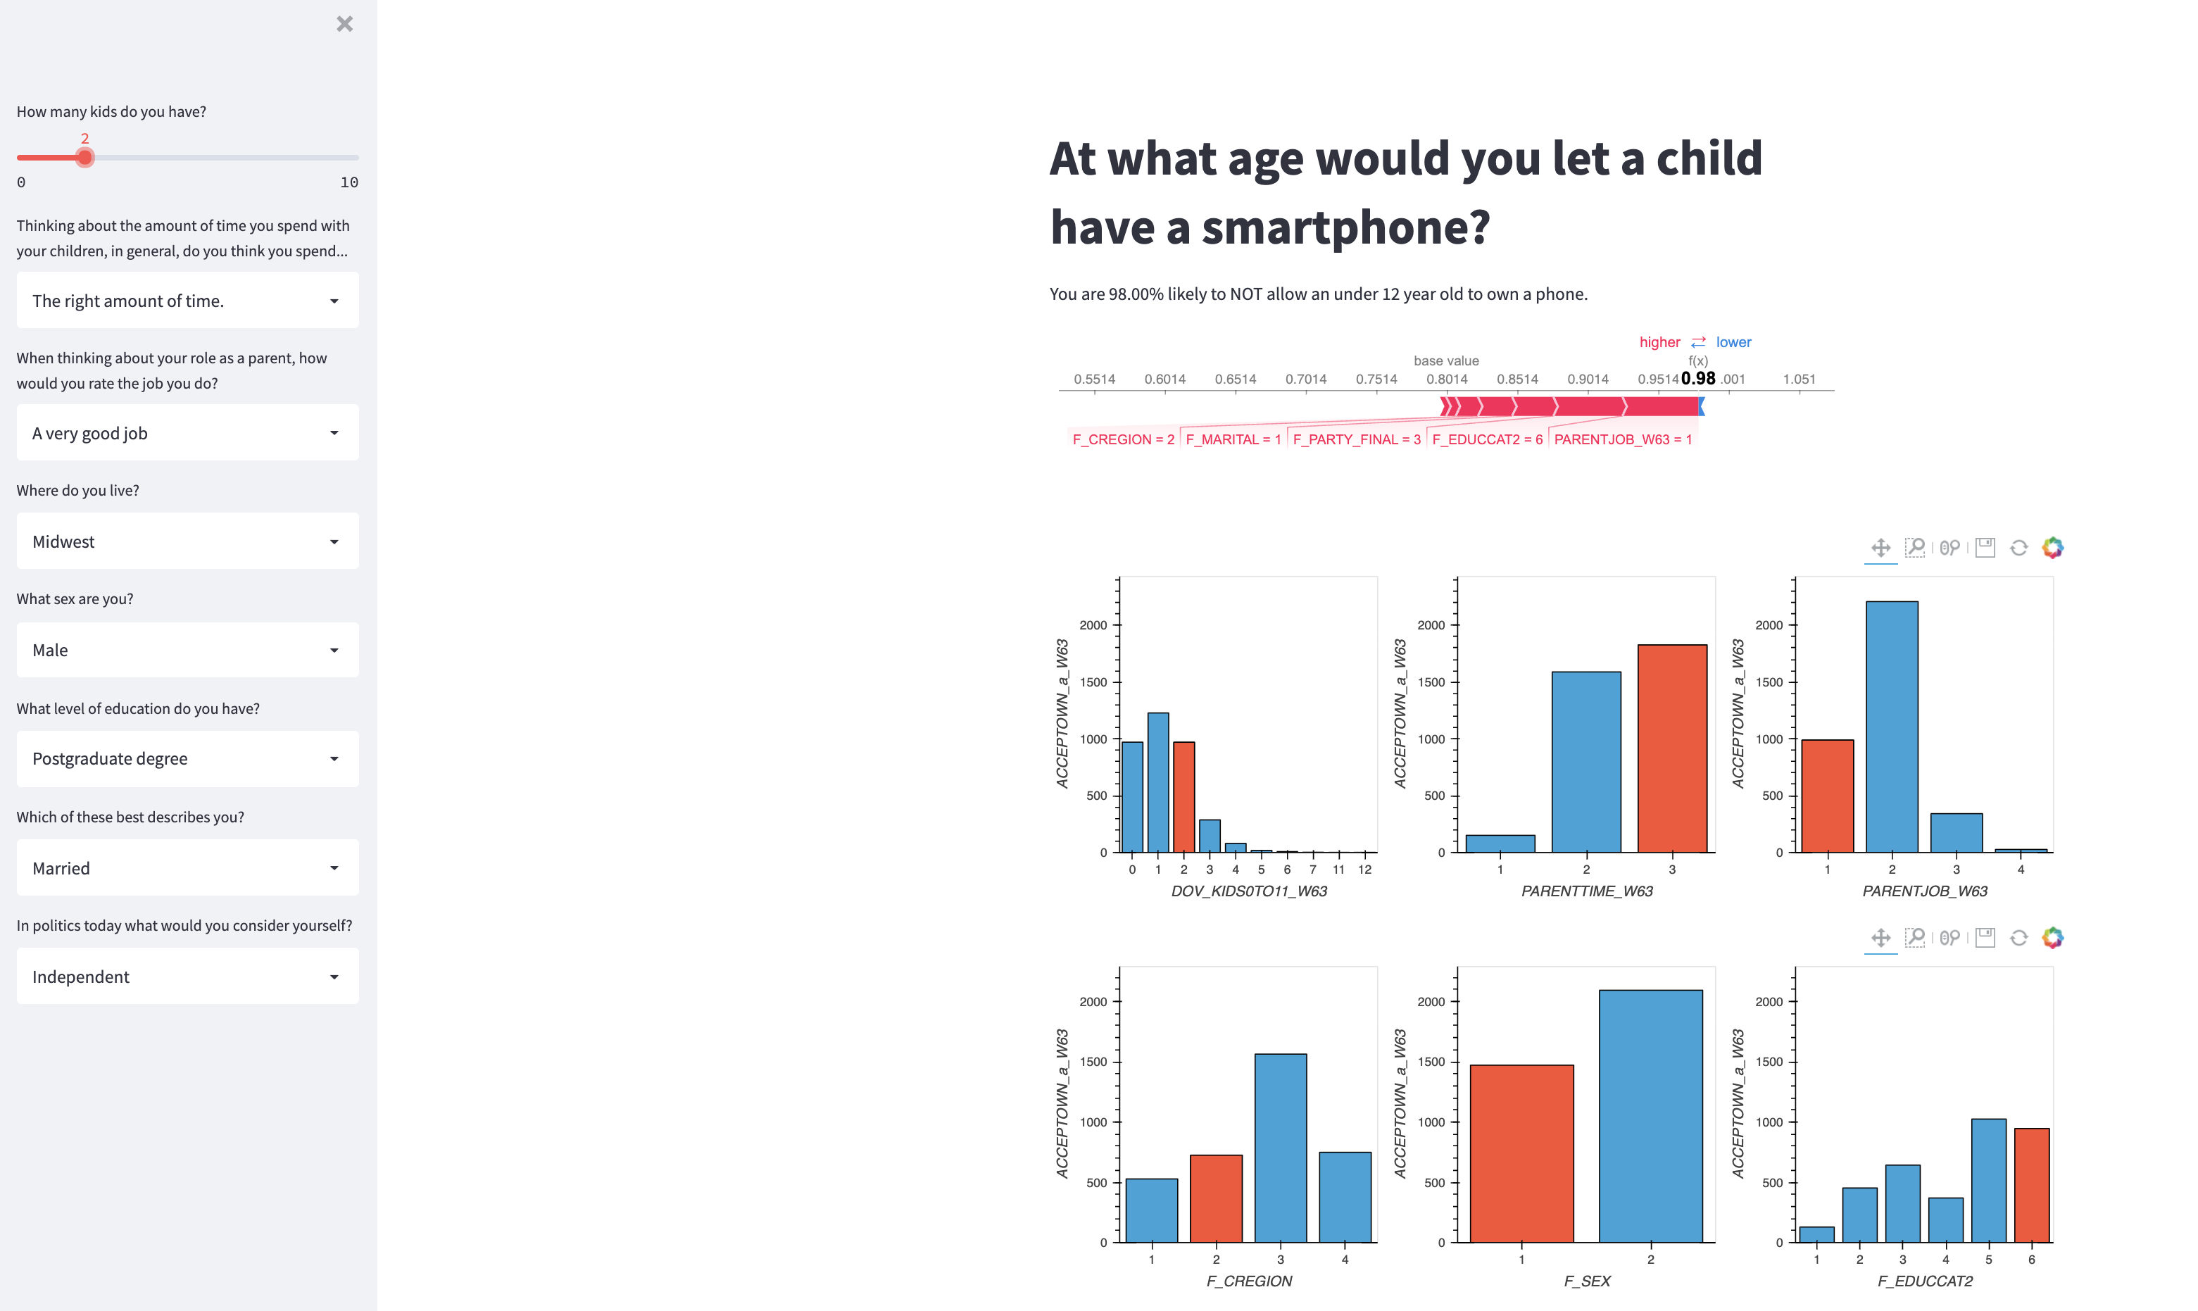
Application

Slide 8
Conclusion

